Slide 1

Power Bi Project Amazon E - Commerce
Presented by – Manem Sai Chaitanya

Slide 2
Objective of the Project
Problem Statement
You are working as a business analyst at Amazon, a company currently performing well. The stakeholders wish to maintain this level of performance and seek improvement. For this purpose, they want to devise new strategies. You are part of a team exploring new ways to benefit customers, such as offering more discounts and Prime membership perks. Could you suggest additional methods to identify and reward customers and enhance their shopping experience?
Objective
The goal is to suggest innovative strategies and programs to recognize, honor, and assist consumers, ultimately improving their shopping experience and supporting Amazon's ongoing success.

Slide 3
Data points for consideration
Total revenue = 10,72,39,297.20.
Total number of unique customers who made purchases each year = 113000 Customers.
Unique Products = 44 Unique Products.
Average Delivery Days = 9.41 Days.
Returned Products Count = 30526

Slide 4
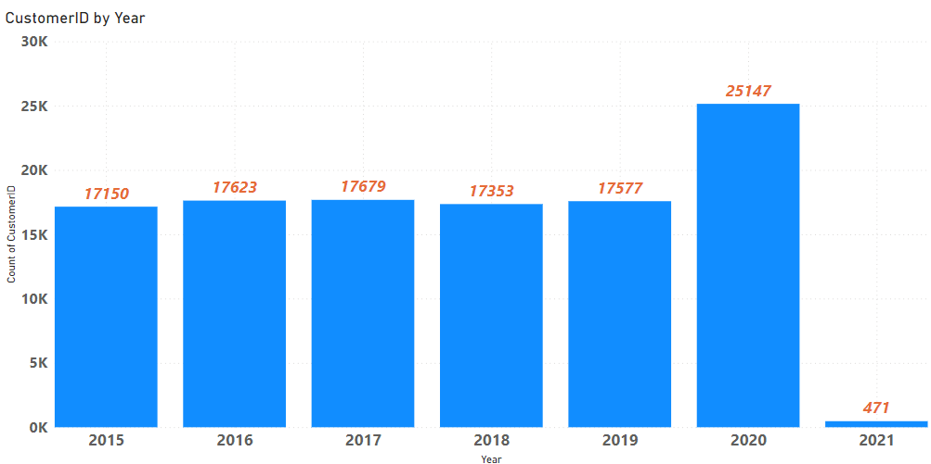
Unique Customers who made purchases each year
Analysis –
As we can see there is a huge drop in sales in year 2021.
The reason behind drop in sales may be because of Covid.
As everywhere it’s lockdown, and the main business which impacted because of lockdown is e-commerce model.

Slide 5
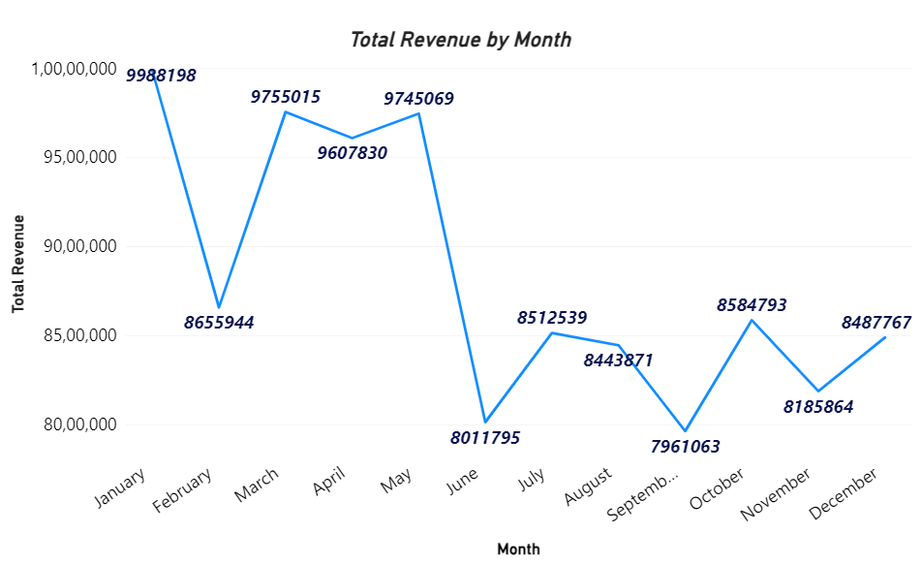
Month Analysis
Suggesting some targeted marketing strategies :-
Implementing specialized social media advertising campaign to connect with prospective customers by sending them customized marketing messages.
Starting specialized email marketing campaigns to inform current customers and inform about exclusive deals and incentives.
To reward consumers for purchases made during promotional periods and promote repeat business, to improve loyalty programs.
Providing bundled packages, discounts, or promotions in line with holidays or other festival occasions that fall within the specified months (June, September & November).
Using flash sales or limited-time promotions to create a sense of urgency and promote quick purchases.

Slide 6
Strategies to increase the sales of the low-selling items:-
Identifying low-selling items by looking at products with lower revenue contributions, I have used Background colour option with rules <=100000 for low-selling item.
Conducting market research to understand why low-selling items are not performing well and identifying reasons like low demand, high competition, or product quality issues.
Developing targeted marketing campaigns to promote low-selling items which could include discounts, special offers, or advertising which caters to specific customer segments.
Making improvements to low-selling items based on customer feedback or market trends which could include product redesigning, changes in features, or pricing changes.
Engaging with customers to gather feedback and understand their preferences and we can use this information for product offerings and improve the overall customer experience.

Slide 7
Resource Allocation approach
.
Maintaining a close eye on market dynamics and revenue distribution to adjust resource allocation for shifting market conditions.
Determining which markets or areas are performing well for focused marketing initiatives, then allocate resources appropriately.
Considering the elements like the competitive landscape, purchasing patterns, and demographics of the population in each geographic area.
Concentrating on advertising, marketing, and promotional efforts on areas with the greatest potential for revenue contribution.
Streamlining supply chain processes and distribution networks to effectively meet demand in strategic regions

Slide 8
Strategies for Loyalty Program
The goals of loyalty program is to boost sales, retaining customers, or obtaining customer information for targeted advertising.
Creating several membership tiers according to the amount of money or level of interaction from customers. Bronze, Silver, Gold, and Platinum are typical tiers, with benefits growing as users advance through the ranks.
Establish the requirements that customers must meet in order to be eligible for each tier, such as annual spending, frequency of purchases, or duration of membership.

Slide 9
Strategies to decrease the low rating orders
Providing customers who need their orders delivered faster with options for expedited shipping.
Customers should be aware of shipping options and related delivery times when they are checking out.
To encourage quicker delivery, providing rewards or discounts for selected premium shipping options.
To reduce customer dissatisfaction, monitoring and quickly addressing issues related to product quality.
Giving customers systematic product reviews and specifications so they can make well-informed purchases.
Utilize tools like chatbots to help customers right away.
Reach out to unhappy customers to resolve their issues and avoid bad reviews or ratings.

Slide 10
Strategies to optimize scheduling and staffing to reduce wait times:-
For optimizing delivery scheduling, using of logistical software and sophisticated routing algorithms will help. Orders are grouped according to location in order to reduce travel time and guarantee effective delivery scheduling.
Placing flexible staffing models,which can demand using part-time workers to accommodate varying delivery demands or recruiting more delivery drivers during busy times.
Working with outside logistics companies to increase delivery reach and capacity. Amazon can expand its delivery areas and shorten customer delivery times by utilizing a network of delivery partners.
To accommodate higher order volumes and quicker delivery times, making investments in modernizing transportation infrastructure and growing the capacity of inventory centres. This could entail investing in transportation technology like drones or constructing new inventory centres in key locations.

Slide 11
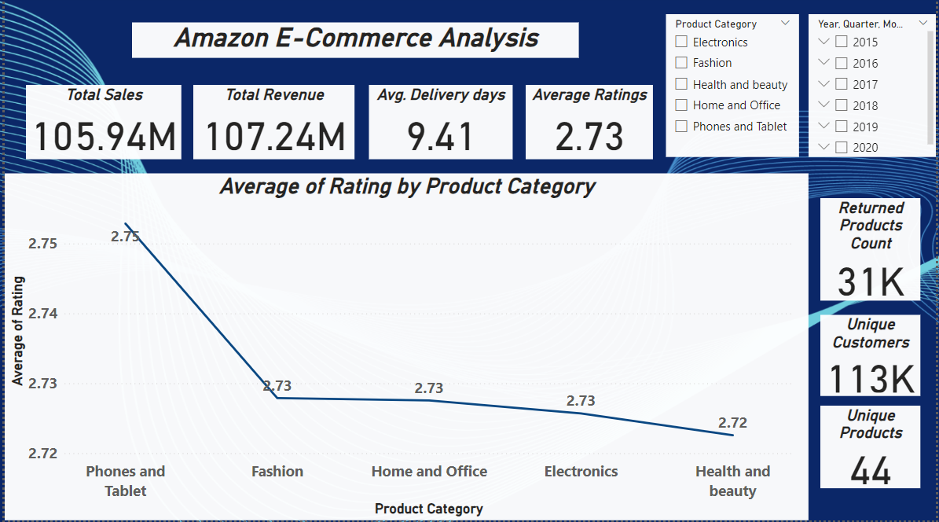
Main Tab

Slide 12
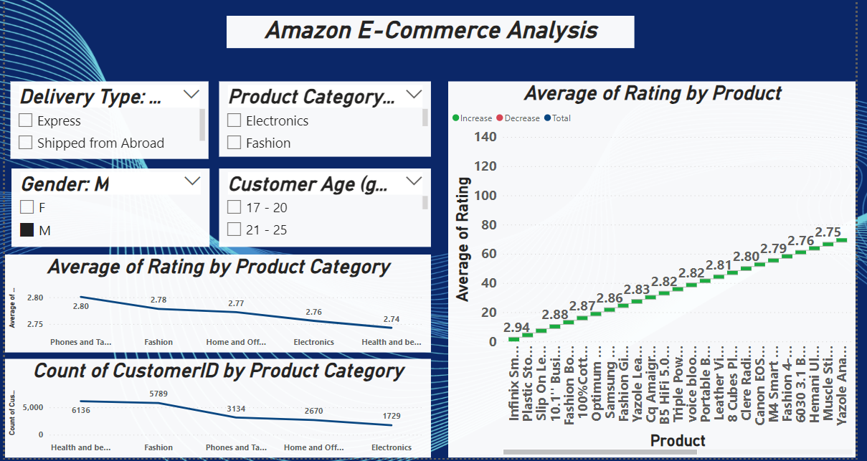
Product Tab

Slide 13
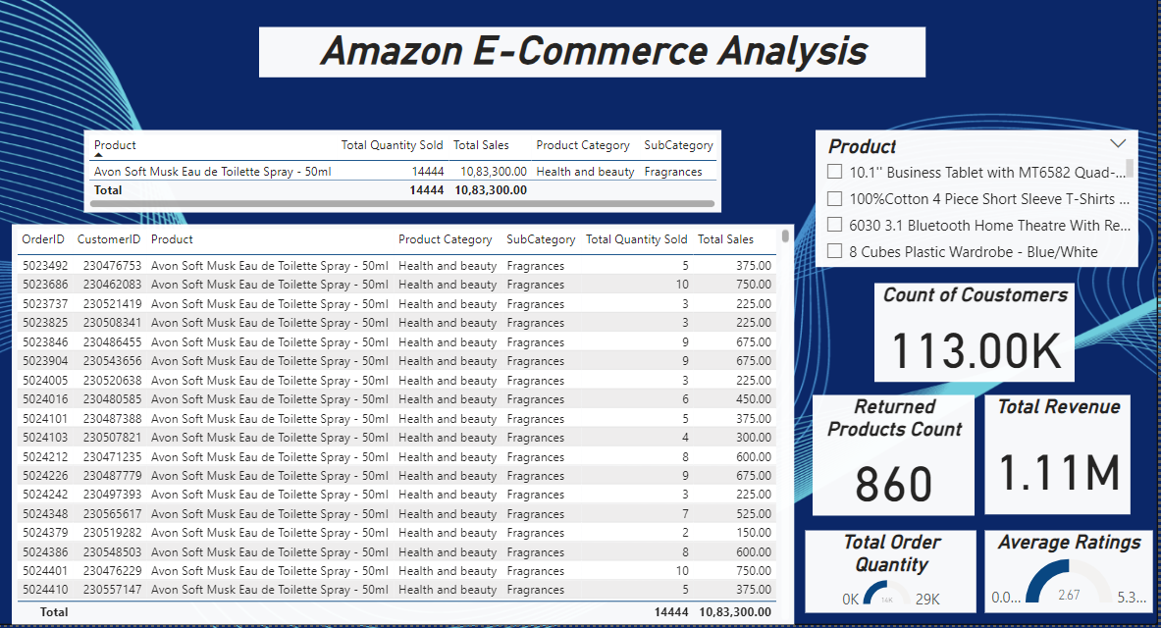
Individual Product Tab

Slide 14
Conclusion
Need to work on strategies for improvement of “Electronics” product category, and the strategies are suggested.
Need to work on improving customer satisfaction (ratings).
Need to work on regular business (standard sales month wise), have already suggested the strategies.
Have to work on pricing strategy as well (discounts, etc.)
Have suggested the loyalty program idea.
Have suggested strategies for staffing which reduce wait – time of delivering the product.
Need a focused marketing strategies for all the above mentioned changes.

Slide 15
Thank You

